Slide 1
Scale Diagrams
Miss L
Year 12 Essentials

Slide 2
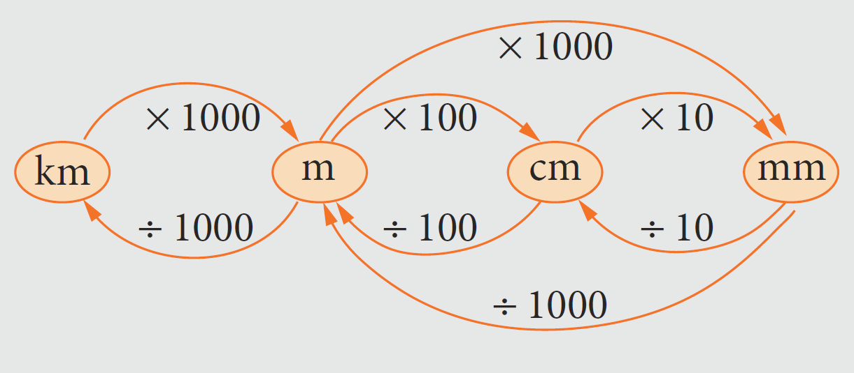
From Last Lesson

Slide 3
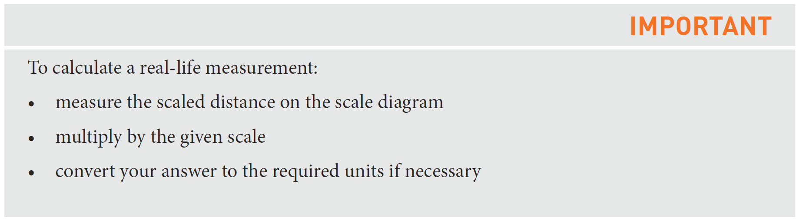
24
7
30
Scale Diagrams
Date
EQ – How do you use a scale diagram?
What is a scale diagram?
Is a reduced or enlarged version of a real object.
The most common scale diagrams are maps and house plans
How to use a scale diagram?

Slide 4
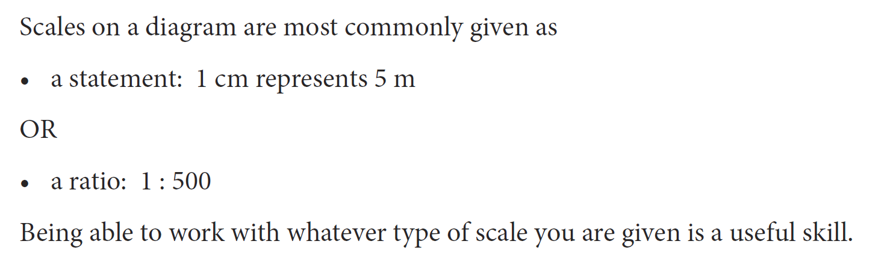

Slide 5
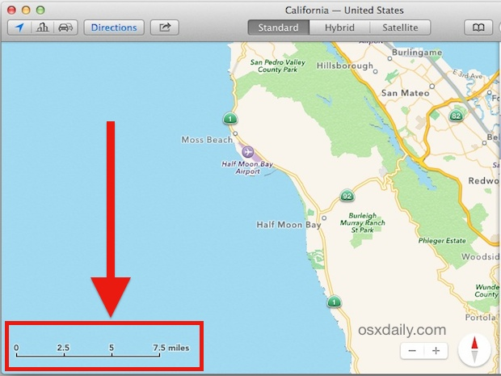
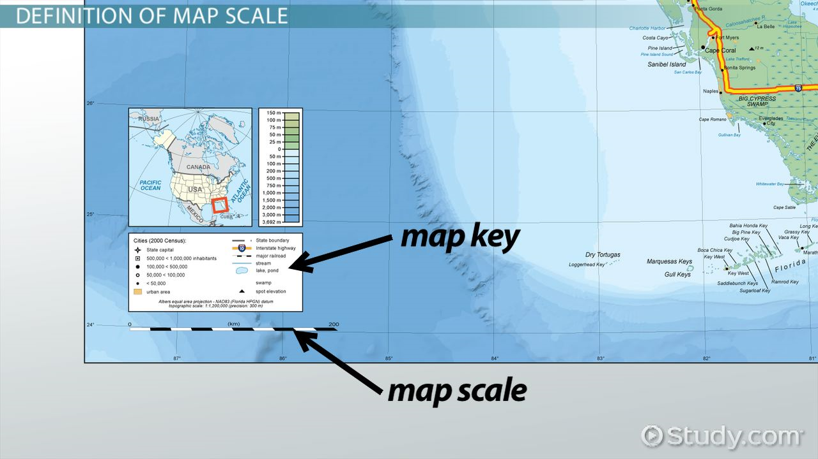

Slide 6


Slide 7
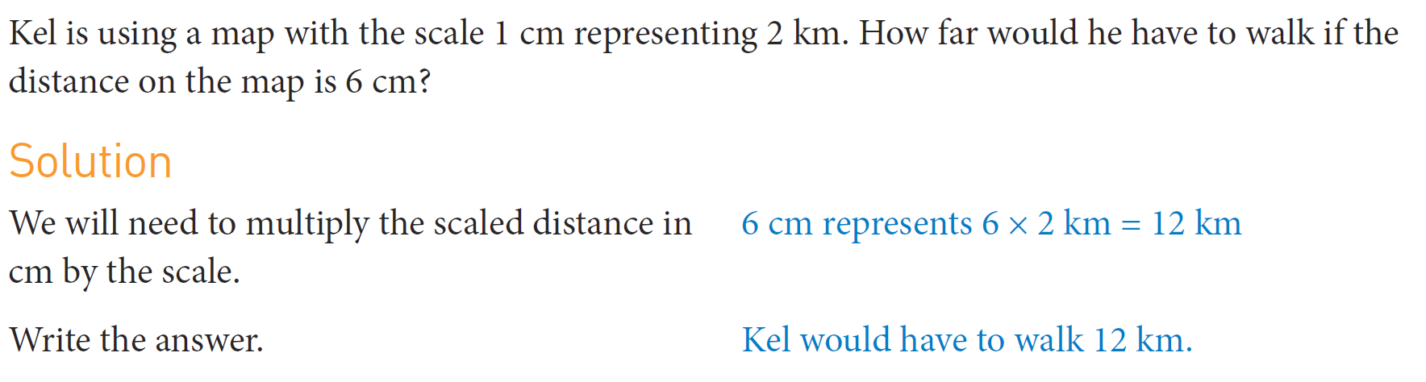
Practice

Slide 8
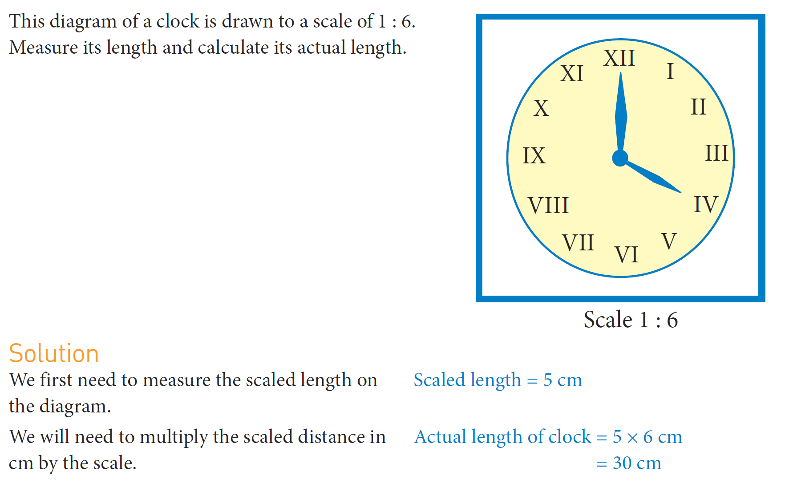
Practice

Slide 9
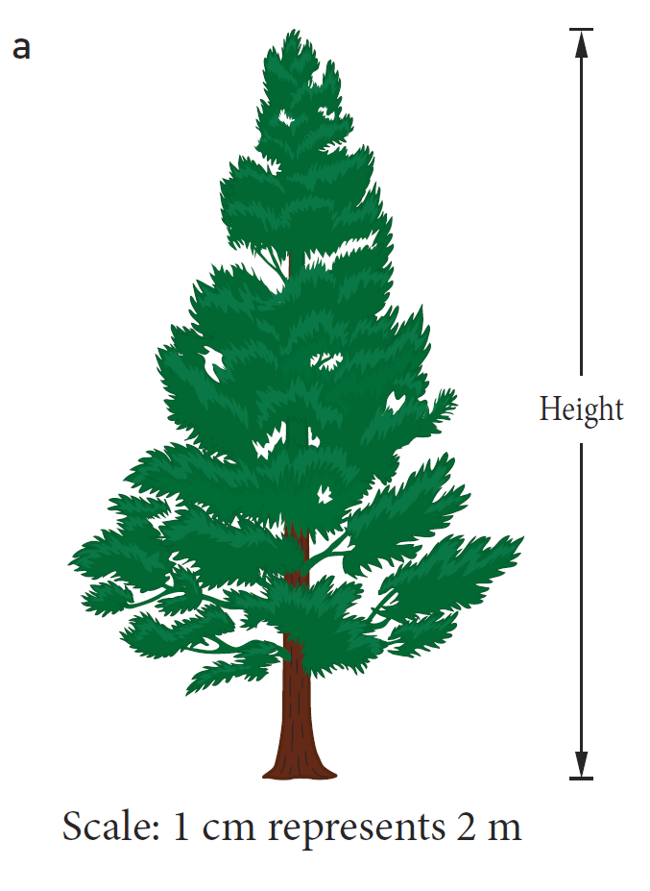
Practice

Slide 10
Task
Scale Diagram Worksheet

